Slide 1
YouTube Trending ‘Trends’
Daniel Ely

Slide 2
Navigating this project
Codebook – ‘Final Codebook.xlsx’
Work Documentation – ‘testing.xlsx’ and ‘12.15 work’ word document
Unorganized – just documenting that I conducted the tests
Includes information on samples conducted
This powerpoint
-all interpretations/graphics and outputs of tests
Pictured on right - each test and the question it is conducted in
Test | Question it occurs in
Mean/stdev/median/quartiles/min/max/range | Codebook X
Correlation coefficients | Q2
Correlation matrix | Q2
F test | Q1
T test | Q1
Chi-sq | Q3
Regression (linear or logistic) | Q3
anova | Q2
Tukey’s post hoc – bonus | skip
Shpairo wilkes | Q1
Bootstrap confidence intervals | Q1
Bar charts | Q1
Dot charts | Q3
Individual scatterplot | Q2
Scatterplot matrix | Q2
Regression line | Q2
qqplot | Q1
qqline | Q1
Density plot | Q2
histogram | Codebook
boxplot | Q1

Slide 3
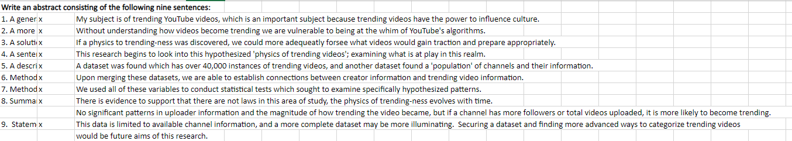
Abstract + Statement Of Interest
What is your subject of interest, and why does it interest you?
The subject of this paper is trending YouTube videos, it interests me because I have spent many hours on YouTube, and I'd like to investigate what video virality.

Slide 4
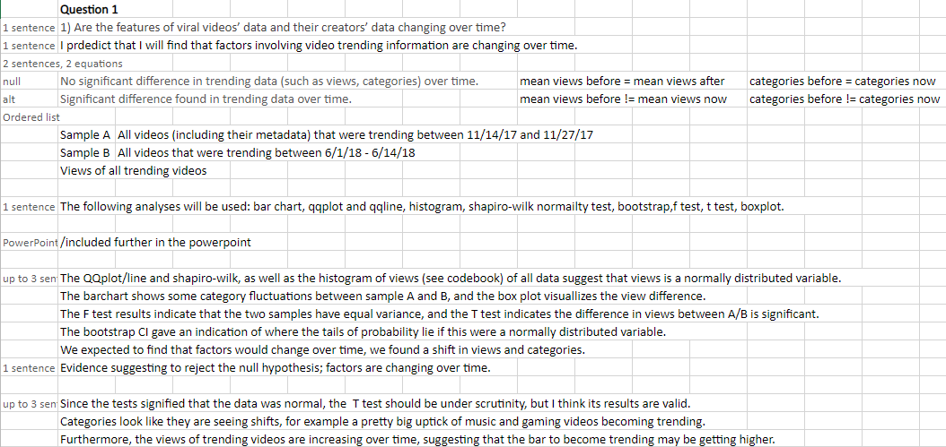
Question 1

Slide 5
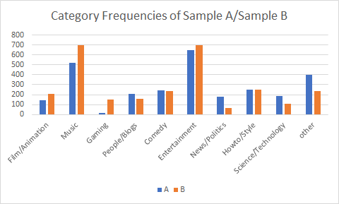
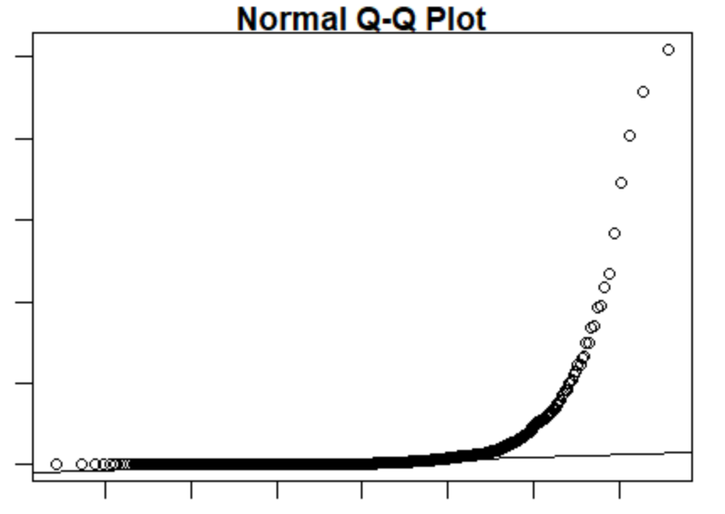
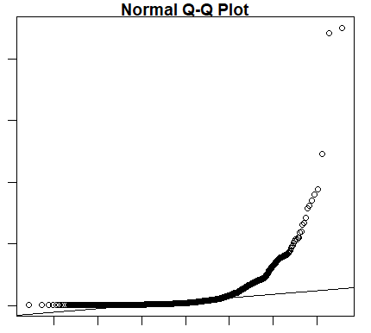
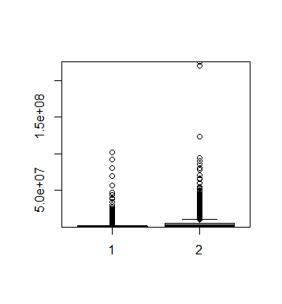
Q1 Documentation
Sample A Sample B
View counts of Sample A/Sample B
> shapiro.test(sampleA$views)
Shapiro-Wilk normality test
data: sampleA$views
W = 0.22581, p-value < 2.2e-16
> shapiro.test(sampleB$views)
Shapiro-Wilk normality test
data: sampleB$views
W = 0.41081, p-value < 2.2e-16
Bootstrap confidence intervals aggr(SampleA + Sample B)
2.5% 97.5%
2997784 3421820

Slide 6
Q1 Documentation
F-Test Two-Sample for Variances
 | views | views
Mean | 1260533.23 | 5150089
Variance | 2.06771E+13 | 1.08E+14
Observations | 2800 | 2800
df | 2799 | 2799
F | 0.191308835
P(F<=f) one-tail | 0
F Critical one-tail | 0.939703112
t-Test: Two-Sample Assuming Equal Variances
 | views | views
Mean | 1260533.23 | 5150089
Variance | 2.06771E+13 | 1.08E+14
Observations | 2800 | 2800
Pooled Variance | 6.43798E+13
Hypothesized Mean Difference | 0
df | 5598
t Stat | -18.1379964
P(T<=t) one-tail | 8.61362E-72
t Critical one-tail | 1.645125871
P(T<=t) two-tail | 1.72272E-71
t Critical two-tail | 1.960387846

Slide 7
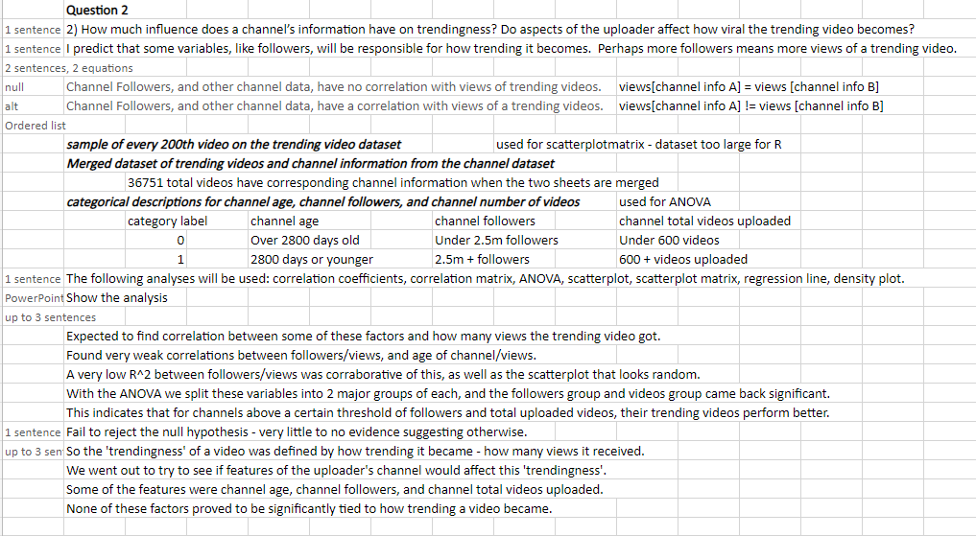
Question 2

Slide 8
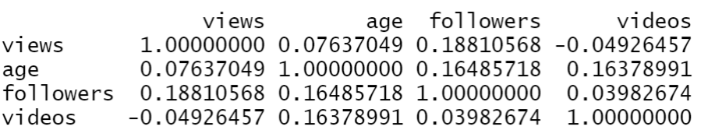
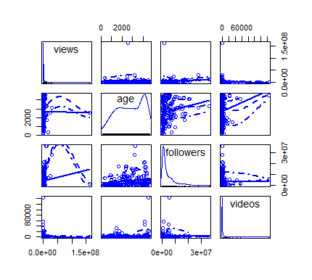
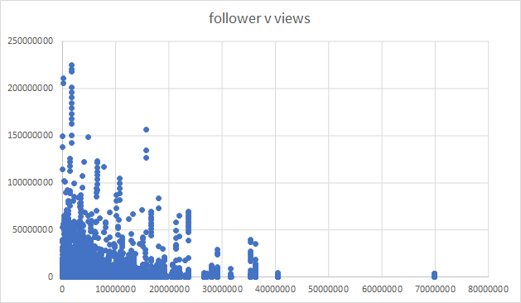
Q2 Documentation
Source -> all trending videos with uploader information (36751)
Input -> sample of every 200th video

Slide 9
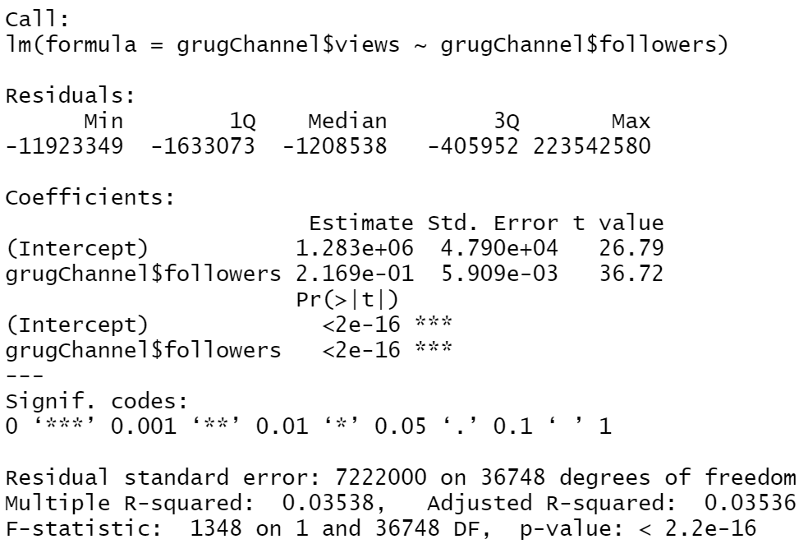
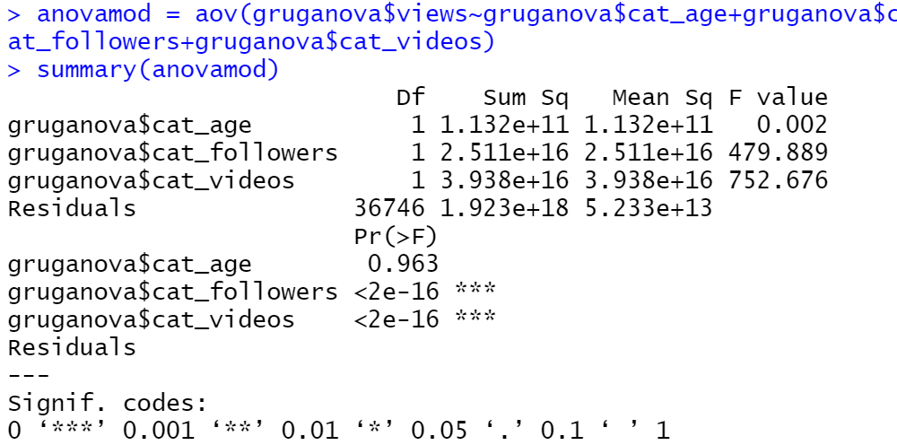
Q2 Documentation

Slide 10
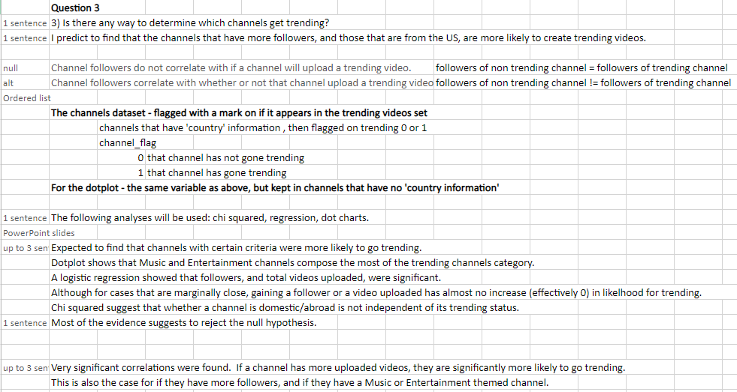
Question 3

Slide 11
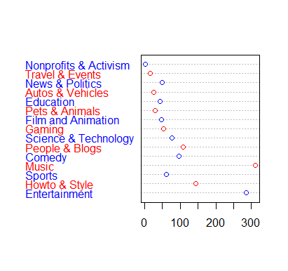
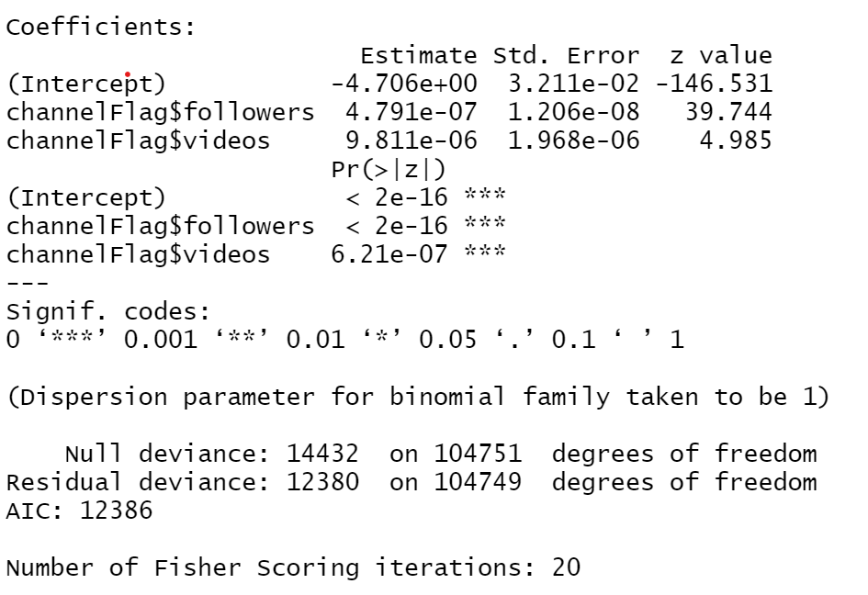
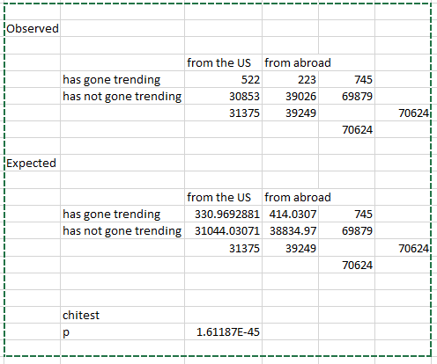
Q3 Documentation
The following analyses will be used: chi squared, regression, dot charts.

